Slide 1



Users' Perceptions of AI Coding Assistants
Yunbo Lyu 吕允博
PhD Candidate at Singapore
July 17th, 2025, at Yang Zhou University

Slide 2

Integrated Development Environment (IDE)
What IDE do you currently use?

Slide 3




Integrated Development Environment (IDE)
Notes:
VS Code, Visual Studio, Intellj, Eclipse, Jupyter Notebook,

Slide 4


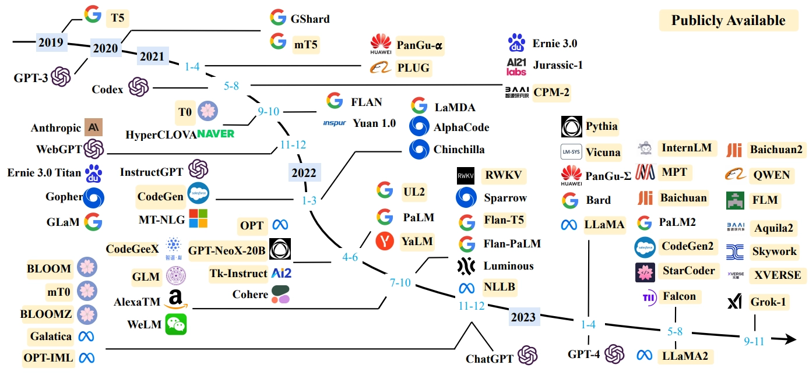
Mature with the AI Coding Assistants
October 2021
November 2022

Slide 5
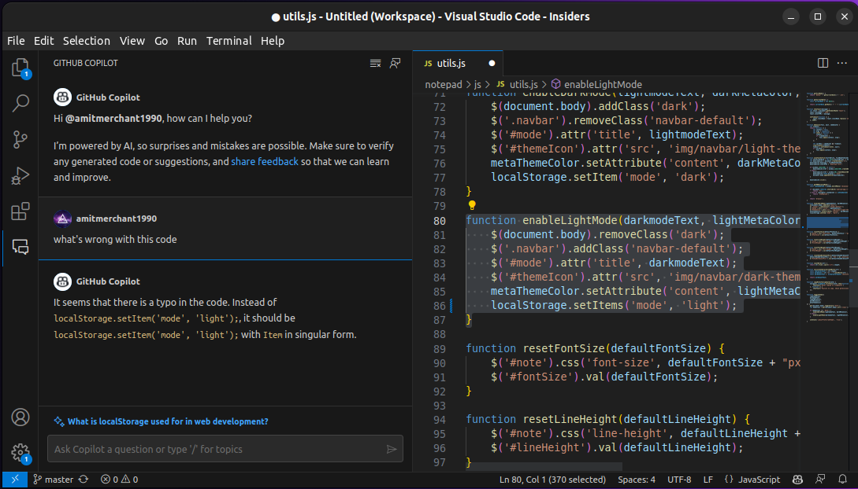

In-IDE AI Coding Assistant
Coding Area
Interact with the AI coding assistant

Slide 6

In-IDE AI Coding Assistant
Code Completion
Chat Interface
Agent Mode

Slide 7
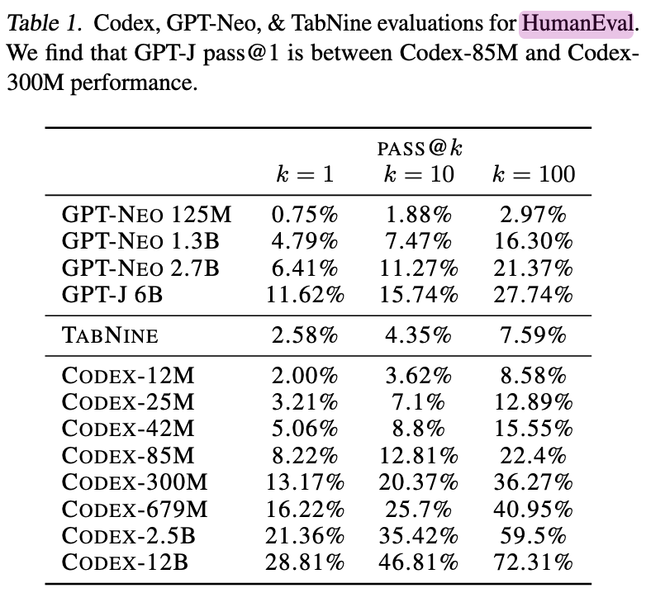
In-IDE AI Coding Assistant
October 2021
November 2022
Perform good on the benchmark

Slide 8





Question
With the boost of AI Coding Assistants,
how do users perceive them?

Slide 9

Question
With the boost of AI Coding Assistants, how do users perceive them?
Boost in productivity?

Slide 10

Question
With the boost of AI Coding Assistants, how do users perceive them?
Find a Solution?

Slide 11

Question
With the boost of AI Coding Assistants, how do users perceive them?
Distracted?

Slide 12
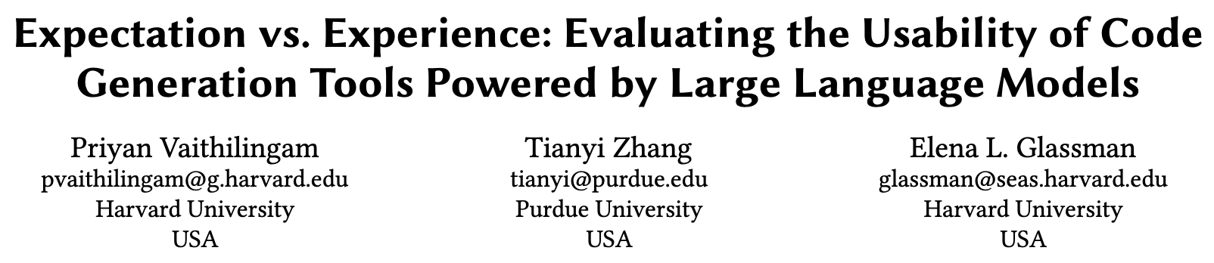
Both in Academia the Industry Curious
October 2021
CHI 2022 Citations: 786
Vaithilingam, Priyan, Tianyi Zhang, and Elena L. Glassman. "Expectation vs. experience: Evaluating the usability of code generation tools powered by large language models." In Chi conference on human factors in computing systems extended abstracts, pp. 1-7. 2022.

Slide 13
1. Expectation vs. Experience
Problem
AI coding assistants’ real-world usability and how they fit into a developer’s workflow.
Method
User study (N=24) comparing Copilot vs. VS Code’s IntelliSense across three Python tasks (easy/medium/hard).
Measured task success, completion time, and subjective preferences.

Slide 14
1. Expectation vs. Experience – Key Findings
No significant boost in completion time or success rate with Copilot vs. IntelliSense.
Strong preference for Copilot (19/24), because it:
Provides a useful “jump-start” snippet instead of a blank editor
Cuts down on web searches for boilerplate code
Usability hurdles hinder effectiveness:
Difficult to understand, debug, and edit large AI-generated code blocks
Cognitive overload when navigating multi-line suggestions

Slide 15
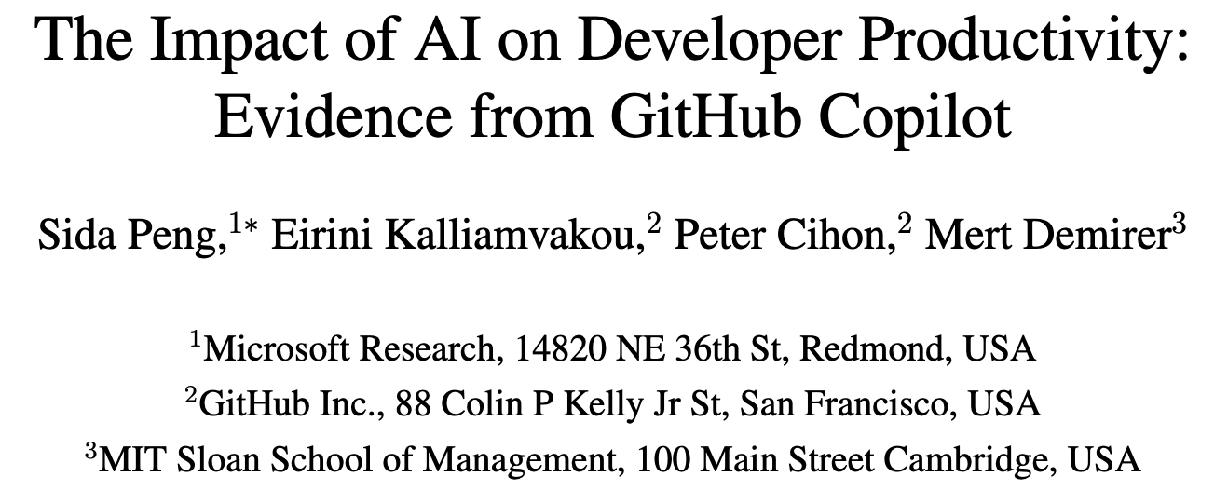
2. Evidence from GitHub Copilot
GitHub 2023, Citations: 582
Experimental Design
• Controlled trial (N=95) on Upwork
• Task: Implement an HTTP server in JavaScript as fast as possible
• Treatment group used Copilot; control group used only web search/Stack Overflow
Research Question: How much can GitHub Copilot boost professional developers’ productivity?
Findings: 55.8% faster task completion with Copilot
Peng, Sida, Eirini Kalliamvakou, Peter Cihon, and Mert Demirer. "The impact of ai on developer productivity: Evidence from github copilot." arXiv preprint arXiv:2302.06590 (2023).

Slide 16
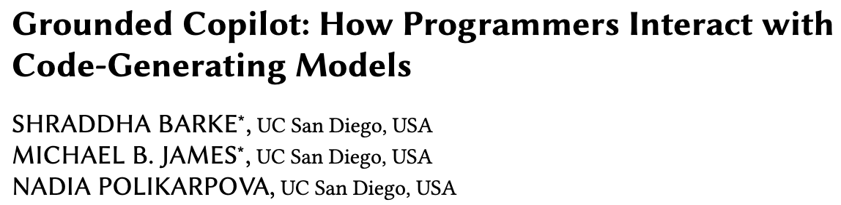
3. Grounded Copilot
OOPSLA 2023 Citations: 458
Interactions with programming assistants are bimodal:
In acceleration mode, the programmer knows what to do next and uses Copilot to get there faster;
In exploration mode, the programmer is unsure how to proceed and uses Copilot to explore their options.
Barke, Shraddha, Michael B. James, and Nadia Polikarpova. "Grounded copilot: How programmers interact with code-generating models." Proceedings of the ACM on Programming Languages 7, no. OOPSLA1 (2023): 85-111.

Slide 17
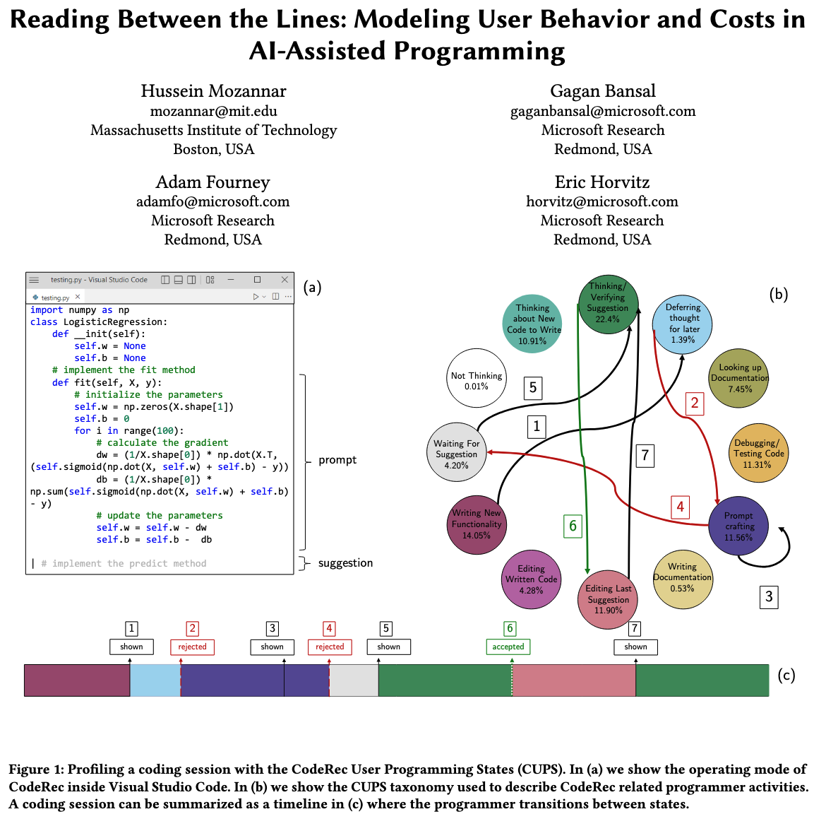
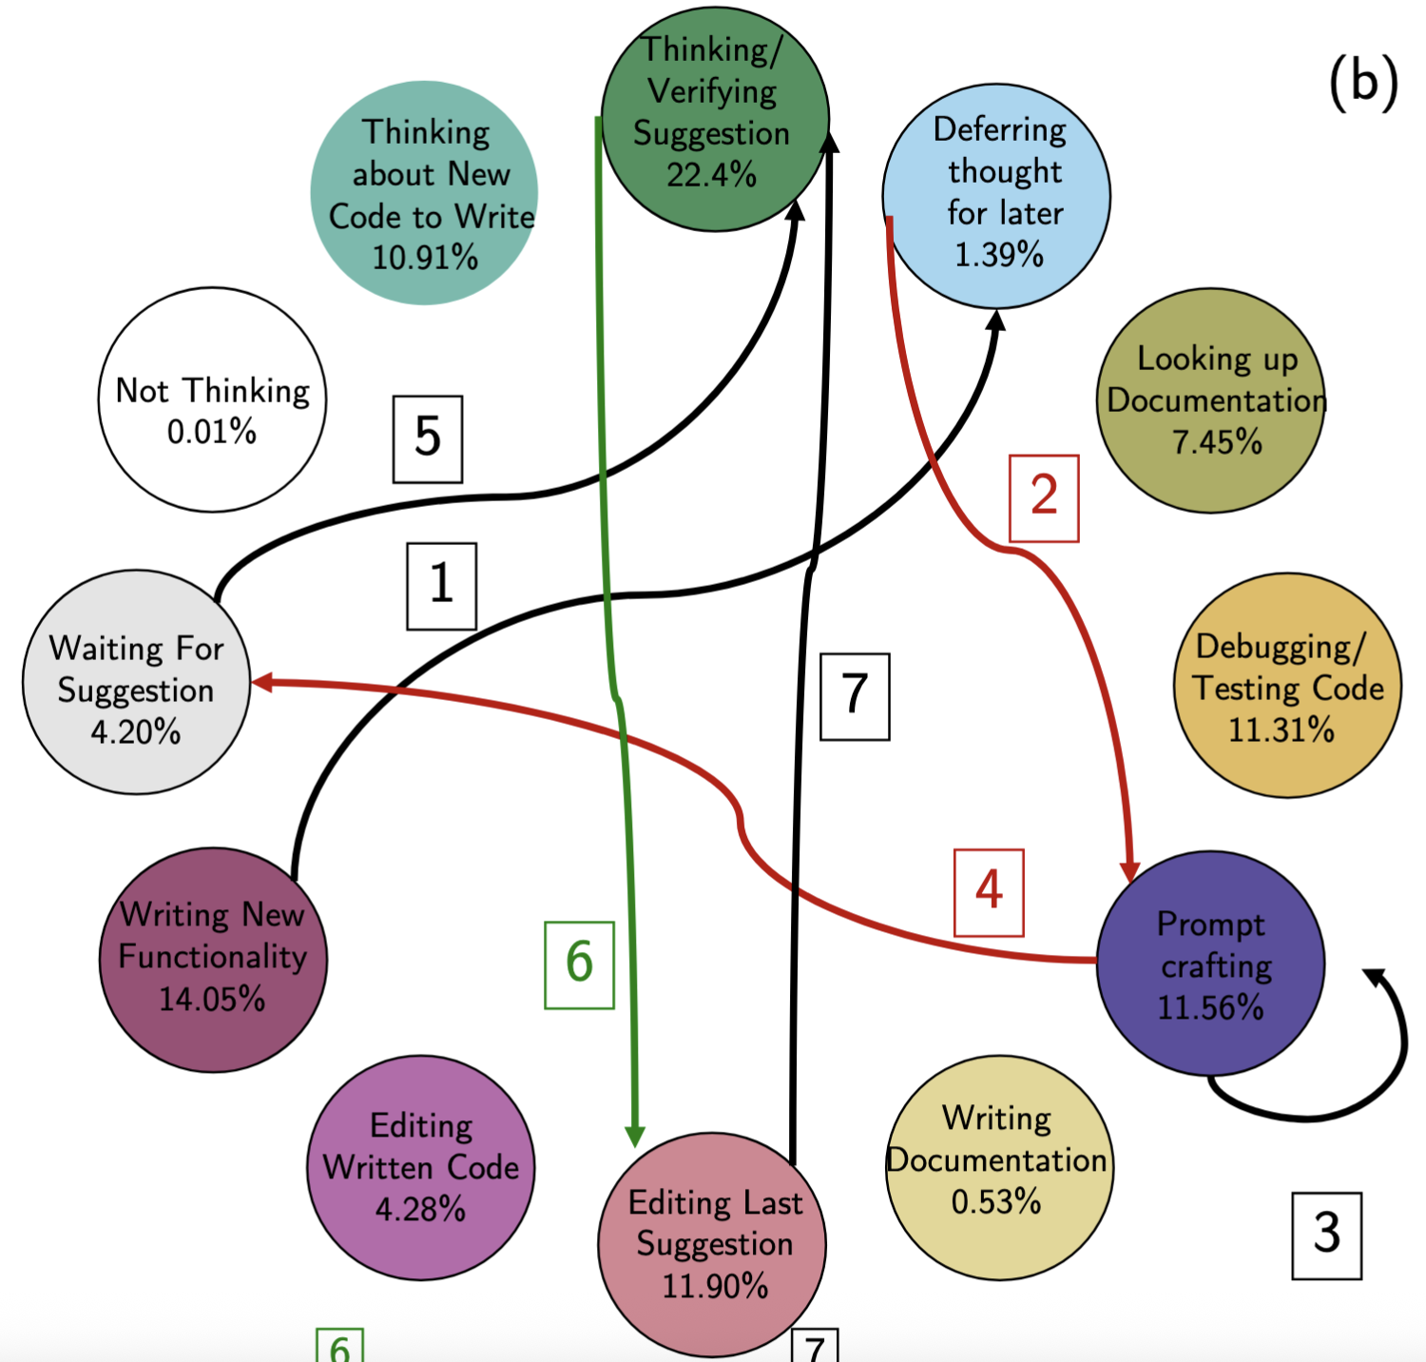
4. Reading Between the Lines
Goals
Introduce and validate CUPS (CodeRec User Programming States), a fine-grained taxonomy and behavioral model of how developers interact with AI code recommendation tools (e.g., Copilot).
Method
Grounded-theory labeling: 21 programmers retroactively annotate 3,137 “telemetry segments” of their real Copilot sessions
CUPS taxonomy defines 12 states (e.g., Prompt Crafting, Verifying Suggestion, Writing New Functionality)
CHI 2024 Citations: 147

Slide 18
4. Reading Between the Lines – Key Findings
Verification dominates: “Thinking/Verifying Suggestion” alone consumes 22.4% of session time
Half the session (51.5%) was spent in Copilot-specific states (prompting, deferring, waiting, editing suggestions)
Deferred verification is common: many acceptances are immediately followed by post-accept reviews, inflating true acceptance costs
Mozannar, Hussein, Gagan Bansal, Adam Fourney, and Eric Horvitz. "Reading between the lines: Modeling user behavior and costs in AI-assisted programming." In Proceedings of the 2024 CHI Conference on Human Factors in Computing Systems, pp. 1-16. 2024.

Slide 19

5. A Large-Scale Survey
ICSE 24 Citations: 197
Core Goal
Understand, at scale, why developers choose (or avoid) AI programming assistants and what usability challenges they face
Method
Surveyed 410 real-world developers across Copilot, Tabnine, ChatGPT, CodeWhisperer, etc., combining quantitative rankings and open-ended feedback
Liang, Jenny T., Chenyang Yang, and Brad A. Myers. "A large-scale survey on the usability of ai programming assistants: Successes and challenges." In Proceedings of the 46th IEEE/ACM international conference on software engineering, pp. 1-13. 2024.

Slide 20
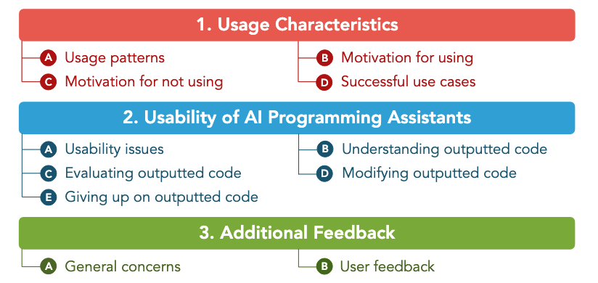
5. A Large-Scale Survey – Key Findings
Motivation for using
Autocomplete & keystroke reduction (86%)
Speed up tasks (76%)
Recall syntax without web search (68%)
Top usability issues
What input led to this suggestion? (30% often)
Giving up and rewriting tool-generated code (28%)
Code generation tool’s suggestions are too distracting (23% often)
Motivation for not using:
Generated code fails to meet requirements (54%)
Hard to control what the tool outputs (48%)
Liang, Jenny T., Chenyang Yang, and Brad A. Myers. "A large-scale survey on the usability of ai programming assistants: Successes and challenges." In Proceedings of the 46th IEEE/ACM international conference on software engineering, pp. 1-13. 2024.

Slide 21
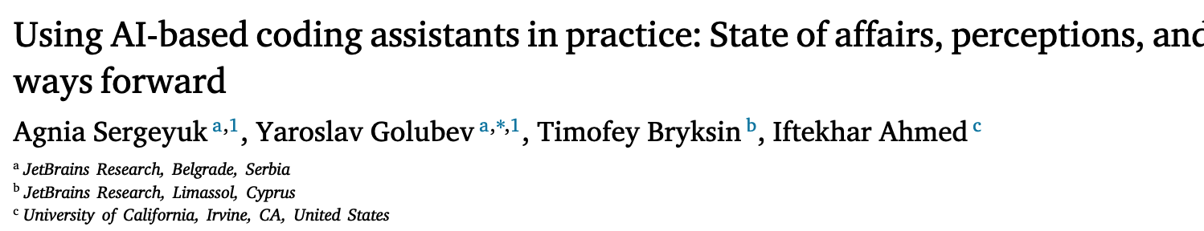
6. Using AI-based coding assistants in practice
Core Goal
Conduct a large-scale survey (N = 481) to map exactly where, how, and why developers use (or avoid) AI coding assistants across the full software development lifecycle
Five key activities and their stages:
(1) Implementing new features; (2) Writing tests; (3) Bug triaging; (4) Refactoring; (5) Writing natural-language artifacts
Main Findings:
Implementing new features is the most enjoyable and the least likely to be delegated to an assistant, while writing tests and writing natural-language artifacts are the most unpleasant and the most likely to be delegated.

Slide 22
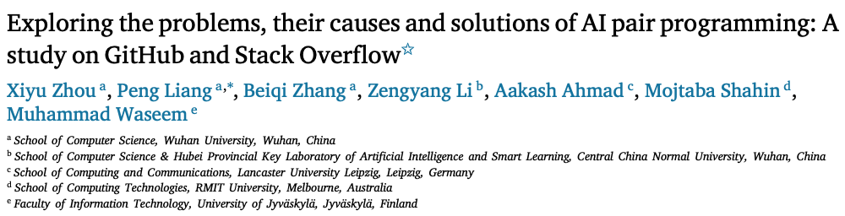
7. Problems, Causes and Solutions
Core goal: Systematically characterize the real-world problems, their root causes, and practical solutions encountered by developers using GitHub Copilot as an “AI pair programmer.”
Data sources: 473 GitHub Issues, 706 GitHub Discussions, and 142 Stack Overflow posts, qualitatively analyzed via grounded coding into taxonomies of problems, causes, and fixes.

Slide 23
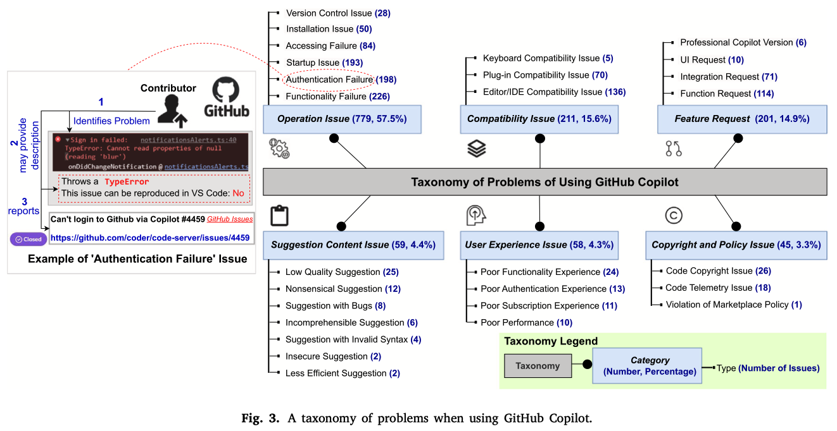
7. Problems, Causes and Solutions
Notes:
Operation Issues (57.5%): e.g. functionality failures, authentication, startup errors
Compatibility Issues (15.6%): IDE/editor or plugin mismatches
Feature Requests (14.9%)

Slide 24
"My productivity is boosted, but ..." Demystifying Users’ Perception on AI Coding Assistants
Under Submission

Slide 25
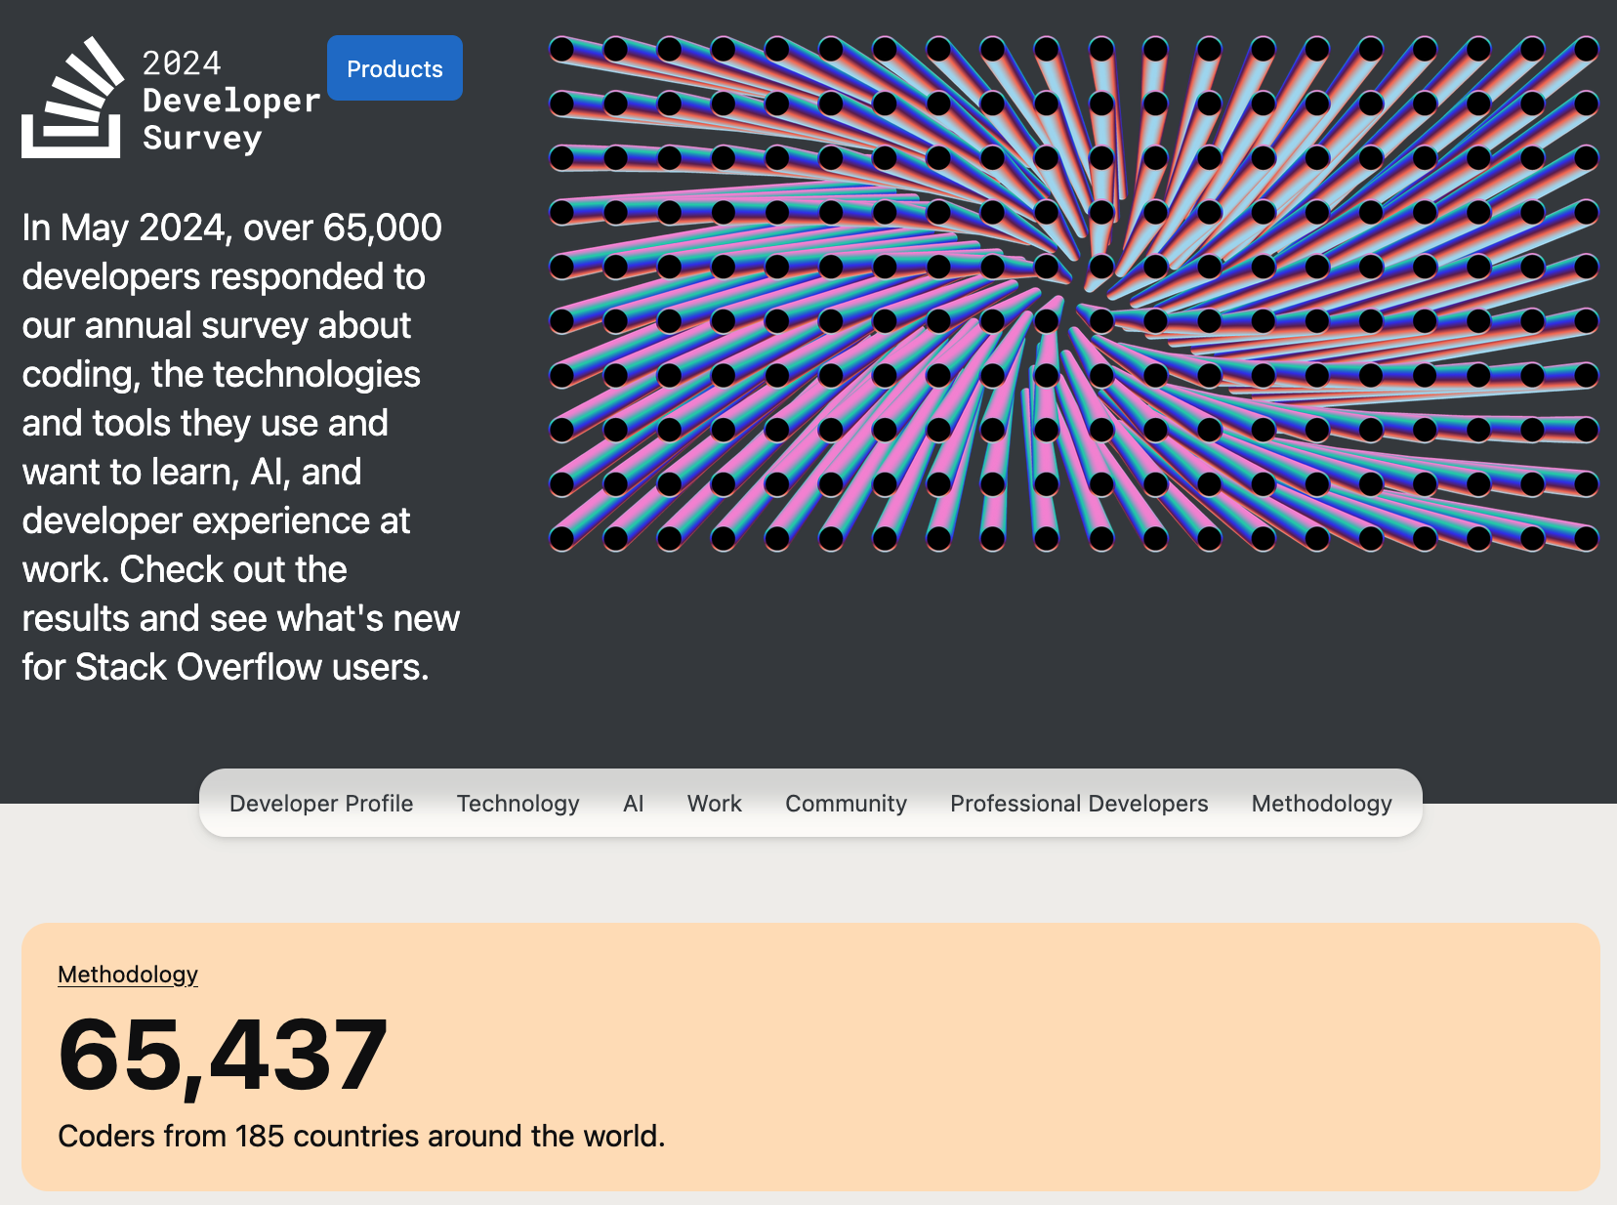
Integrated Development Environment (IDE)
https://survey.stackoverflow.co/2024/

Slide 26
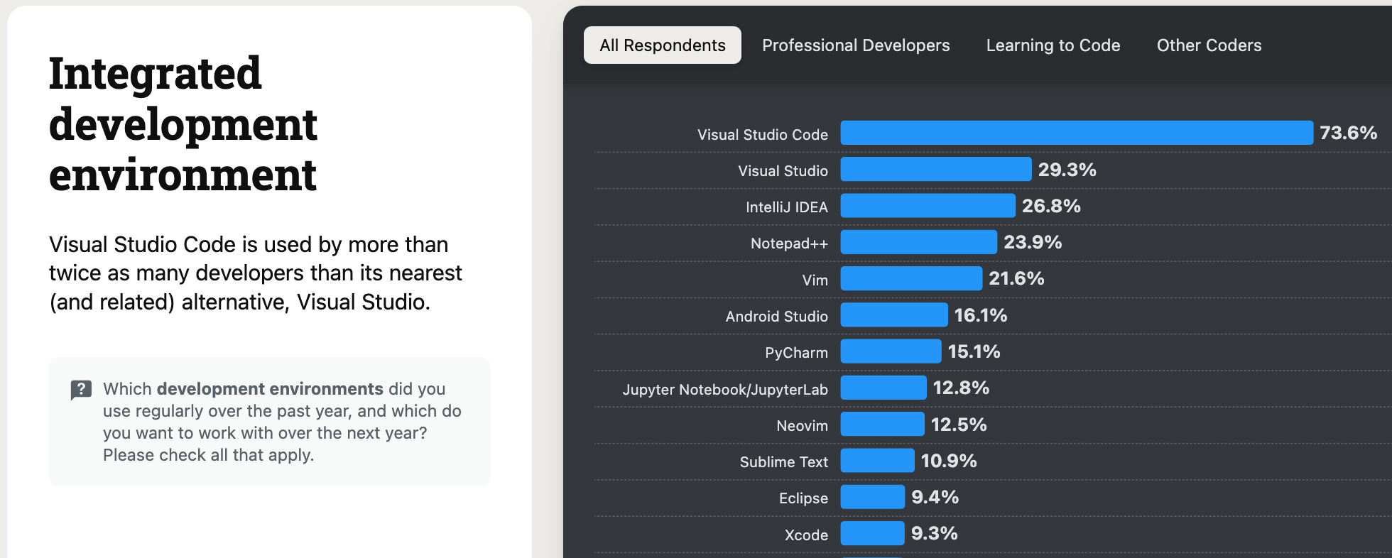
Integrated Development Environment (IDE)
73.6% of developers use VS Code as their primary IDE.
Notes:
VS Code, Visual Studio, Intellj, Eclipse, Jupyter Notebook,

Slide 27
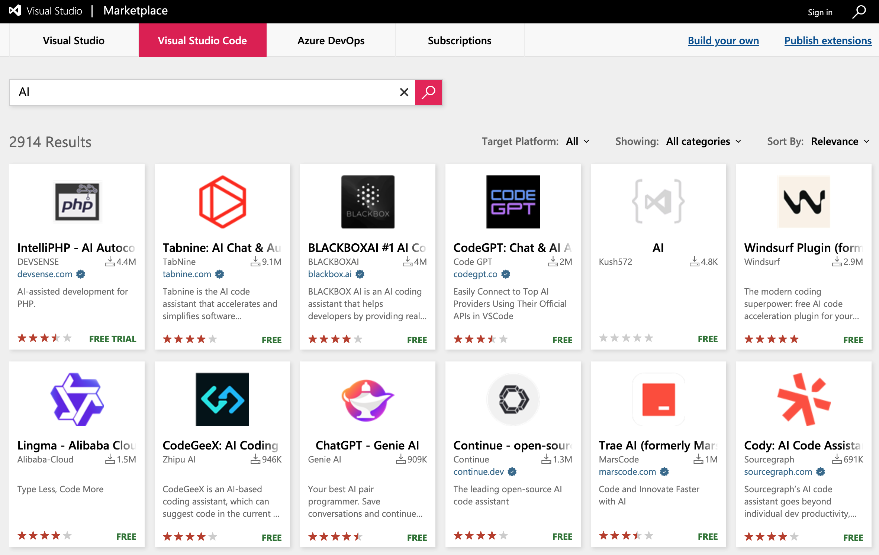
VS Code Marketplace
Thousands of AI Coding assistants in the VS Code marketplace.

Slide 28




AI Coding Assistant

Slide 29
Collecting the AI Coding Assistants
96.37% precision 96.88% recall
66,053
1,962
1,085

Slide 30
VS Code AI Coding Assistants
1.64% of all extensions on the VS Code Marketplace
AI extensions receive significantly more feedback, with an average of 7.48 ratings per extension compared to 1.76 for non-AI extensions
Both AI and non-AI extensions show similar inequality in installs and ratings: The top 10 most-installed AI extensions account for 86% of total installs, and the top 30 most-rated receive 75% of all user ratings
AI extensions have seen rapid growth in recent years

Slide 31
Labeling Taxonomy
Sampled 361 user reviews from 32 popular assistants.
Conduct a Hybrid card sorting:
Started with five predefined top-level categories
Then use bottom-up consolidation
Iterative Coding

Slide 32
Labeling Taxonomy
Developed a 3-level taxonomy
(8 categories, 16 subcategories, 62 labels).

Slide 33
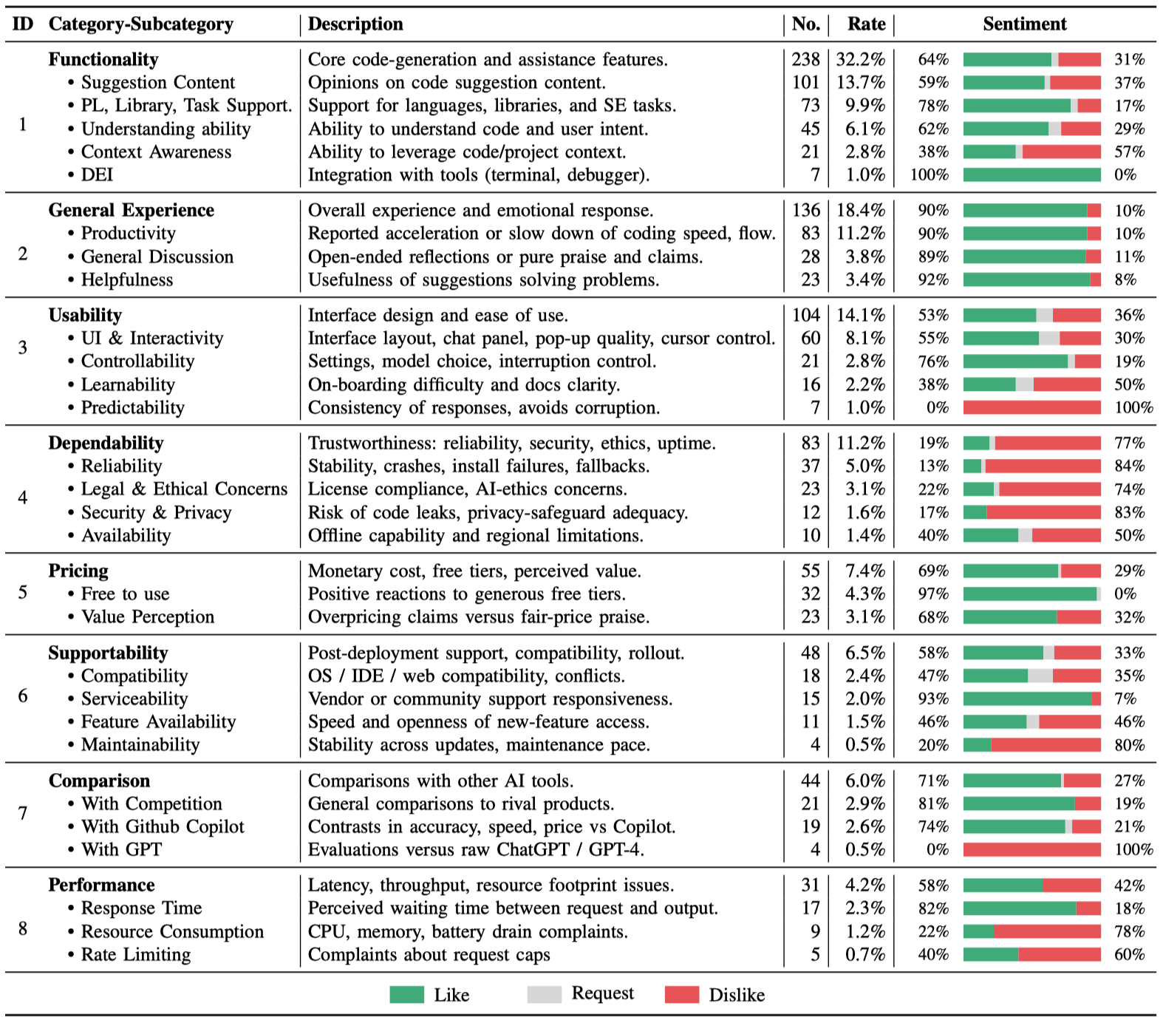
Taxonomy

Slide 34
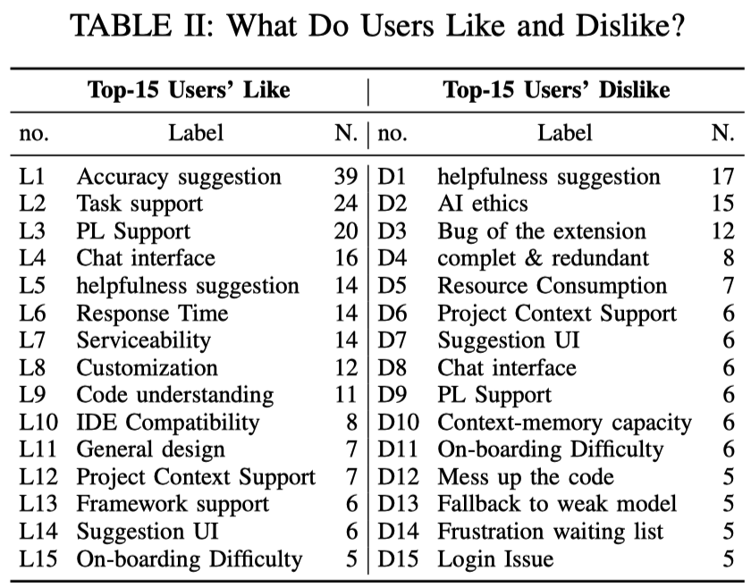
What Do Users Like and Dislike?

Slide 35


Finding 1
1. Productivity Boost is Real—but Not Universal
Most users report productivity gains, especially novices.
Experienced developers are more critical.
“not having to type every single repetitive function out or imports” (R94, 5✰).
“I am a beginner programmer, and it is helping me a lot to build a project” (R319, 5✰).
“For anyone who really knows how to code, save yourself a lot of frustration” (R14, 1✰).

Slide 36
Finding 2
2. Suggestion Quality is the Top Concern
Accurate suggestions are highly valued.
Users dislike redundancy, incompleteness, and buggy outputs.
“80% less keyboard touching. Autocomplete is pure magic. Feels like it’s connected directly to your mind” (R164, 5✰).
“Constantly barfs words on the screen, 90+% is repetitive.”
(R14, 1✰)
“it only predicts one character for me” (R34, 1✰).

Slide 37
Finding 3
3. Context Awareness is a Major Weakness
Assistants can interpret code but struggle to fetch or retain context, especially at the Repository level.
“[assistant] still doesn’t see the class definitions in files that aren’t open” (R1, 1✰).
“[assistant] forgets context on next question and answers irrelevantly even for simple questions” (R22, 1✰).

Slide 38
Finding 4
4. Usability Matters
Poor onboarding and intrusive interface elements can deter users.
“Setup process is bloated. I’ll wait until they make the process more streamlined.” (R265, 1✰).
“While [assistant] aims to simplify coding, some users might find it challenging to adapt to the AI’s suggestions and functionality, especially if they’re used to traditional coding practices.” (R240, 4✰).
“Annoyed suggestions show up at the top”, “Focus doesn’t work, making chat useless...frustrated, don’t use this extension.” (R312, 1✰).
“Messed so much with my code” (R7, 3✰).

Slide 39
Finding 5
5. Resource Consumption is a Pain Point
Users appreciate fast response time but complain about high CPU/memory usage.
Uses too many resources—over 50% CPU and more than 1 GB memory” (R125, 1✰).
“The extension’s performance can sometimes slow down the editor, especially when working on larger files or multi-projects” (R306, 5✰).

Slide 40
Finding 6
6. Pricing and Ethics Influence Adoption
Users prefer free tools and criticize the monetization of open-source trained models.
“It’s a wonderful free alternative of paid AI code assistants”
“Was cool to try out but too expensive now. You are using our code to make money. So, pass for now...but I think you should have a free version (since it’s using open source)” (R42, 1✰).

Slide 41
Recommend Reading
Systematically learn software engineering for software systems with ML components:
1. CMU 17-445/645: Machine Learning in Production (Class)
Empirical Study(Christian Kästner):
2. Collaboration Challenges in Building ML-Enabled Systems:
Communication, Documentation, Engineering, and Process
3. A large-scale survey on the usability of AI programming assistants: Successes and challenges
How to do Taxonomy:
4. Taxonomy of real faults in deep learning systems

Slide 42

Hope it sparks! Questions are welcome.
Contact: 吕允博 (Yunbo Lyu)
Email:
yunbolyu@smu.edu.sg
Personal Website:
https://yunbolyu.github.io
Wechat

